Slide 1
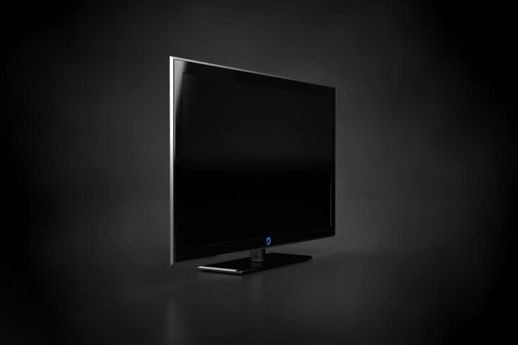
PLASMA
DISPLAYS

Slide 2
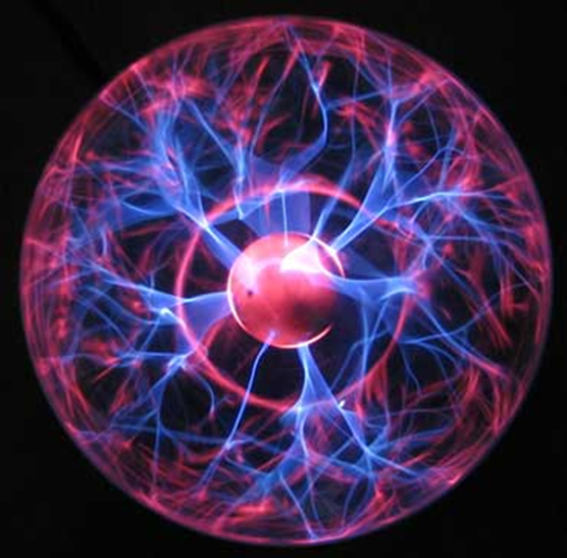
WHAT IS PLASMA?
Gas including ions and electrons. It is considered the fourth state of matter.

Slide 3
PRINCIPLE:

Slide 4
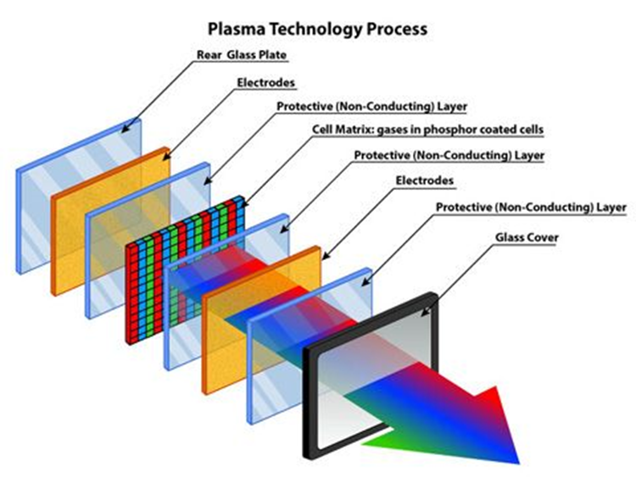
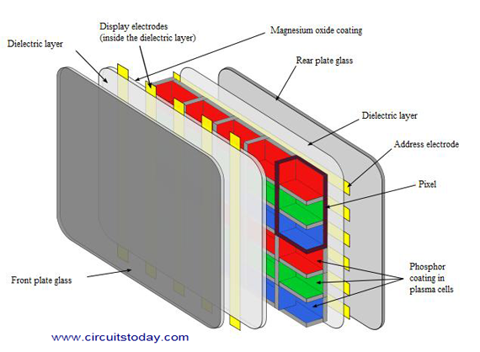
CONSTRUCTION:
Cells containing gases like Xenon and Neon are placed between two glass plates.
The rear glass plate has address electrodes and front glass plate has the transparent display electrode.
The electrodes are surrounded on all sides by a Magnesium oxide layer and a dielectric material.

Slide 5
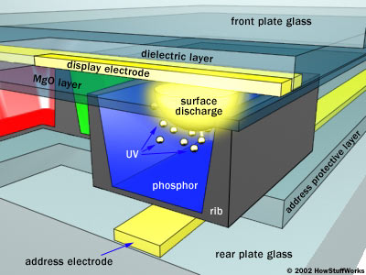
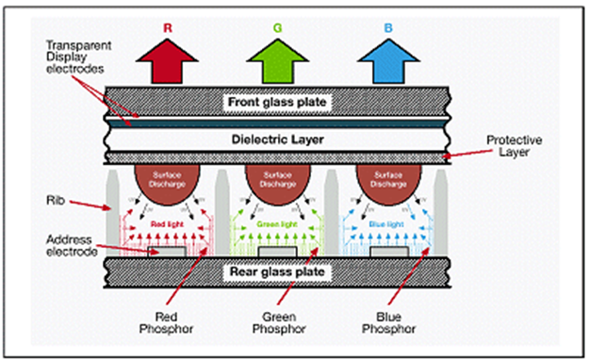
WORKING:
When voltage is applied the electrodes get charged and cause the ionization of gas resulting in plasma.
Collision between the ions results in excitation of electrons to a higher energy state.
When the electrons return to their ground state, energy is released in the form of UV light.

Slide 6
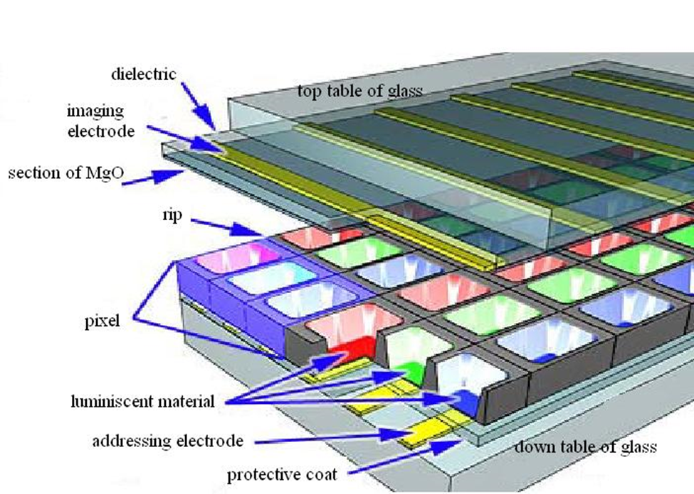
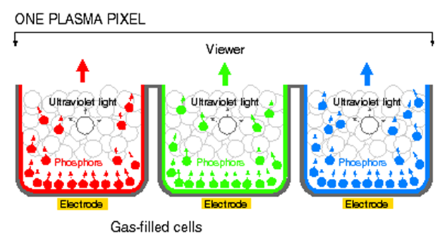
The UV light hits the phosphor layer and causes it to emit visible light.
Each pixel has three composite coloured sub-pixels. When they are mixed proportionally, the desired colour is obtained.
The desired brightness and contrast of each colour can be obtained by controlling the current flowing through each cell.

Slide 7
ADVANTAGES:
Slim display. Very wide screens can be produced using extremely thin materials.
Since each pixel is lit individually, image is bright and looks good from almost all angles.
Has a life span of about 100,000 hours.
Very little motion blur due to high refresh rates and low response time.

Slide 8
DISADVANTAGES
Cost is much higher compared to other displays.
Energy consumption is more.
Cannot be used in high altitudes. The pressure difference between the gas and the air may cause a temporary damage or a buzzing noise.

Slide 9
Thank You!!
DONE BY:
KARTHIYAYINI R.
160051601026
ECE A

