Slide 1
SOLAR CELL

Slide 2
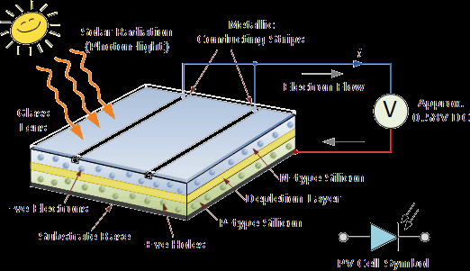
SO LAR CELL
When sunlight is incident on a photovoltaic cell, it is converted into electric energy. Such an energy converter is called solar cell or solar battery.

Slide 3
CONSTRUCTION

Slide 4
ELECTRONICS INSIDE SOLAR CELL
Sun light reaches junction by passing through the glass plate
Incident photon excites the electrons to conduction band thus, creating electron-hole pair
These holes and electron move freely across the junction in a direction opposite to the conventional forward current in a PN-junction
This gives rise to the accumulation of a majority carriers on both sides of the junction which further gives rise to photovoltaic voltage across the junction
To increase the power output, large banks of cells are used in series and parallel combination
Notes:
The e

Slide 5
CHARACTERISTICS:

Slide 6
APPLICATIONS….
It is used in satellites to provide electrical powers.
It is used in a scientific calculators.
It is also used in automobiles and heating systems.

Slide 7
.
Presentation done by:
S.GANESH
ECE –’A’
160051601018

