Slide 1
TUNNEL DIODE
Type | Passive
Working principle | Quantum mechanical effect called tunneling
Invented | Leo Esaki Yuriko Kurose Takashi Suzuki
First production | Sony
Pin configuration | anode and cathode

Slide 2
INTRODUCTION
Tunnel diode is a highly doped semiconductor device. It works on the principle of Tunneling effect.
In normal PN junction diodes the doping levels will be of the order 1 dopant atom in 10⁸ atoms of Si (or) Ge. If the doping levels are increased to 1 in 10³, the depletion layer width is of the order of 10 nm. In such a PN junction tunneling effect is significant, such PN junction devices are called Tunnel diodes.

Slide 3
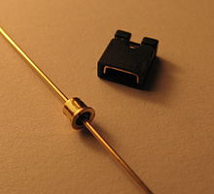
SYMBOLIC REPRESENTATION

Slide 4
TUNNELING EFFECT
According to the classical laws of physics a charged particle order to cross an energy barrier should possess energy at least equal to the energy barrier. Hence the particle will cross the energy barrier if its energy is greater than the barrier and cannot cross the barrier if its energy is less than the energy barrier. But quantum mechanically there exists non zero probability that the particle with energy less than the energy barrier will cross the barrier as if it tunnels across the barrier. This is called as Tunneling effect.

Slide 5
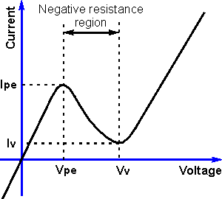
VI CHARACTERISTICS
For small forward voltages owing to high carrier concentrations in tunnel diode and due to tunneling effect the forward resistance will be very small. As voltage increase the current also increases till the current reaches Peak current. If the voltage applied to tunnel diode is increased beyond the peak voltage the current will start decreasing. This is negative resistance region. It prevails till valley point. At valley point the current through the diode will be minimum. Beyond valley point the tunnel diode acts as normal diode. In reverse biased condition also Tunnel diode is an excellent conductor due to its high doping concentrations.

Slide 6
APPLICATION OF TUNNEL DIODE

Slide 7
TUNNEL DIODE
ADVANTAGES
DISADVANTAGES
High speed of operation due to the fact that the tunneling takes place at the speed of light.
Low noise
Environmental immunity
Low power dissipation
Simplicity in fabrication
Longevity
Low output voltage swing
Because it is a two terminal device, there is no isolation between input and output.

Slide 8
THANK YOU
BY
MOHAMMED
.K.
AFRIDI

