Slide 1
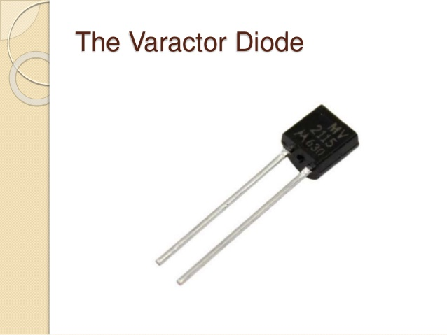
VARACTOR DIODE
BY
SK ISHAQ ANWAR

Slide 2
What is a Varactor Diode?
Varactor diode is a one kind of semiconductor microwave solid-state device and the applications of this diode mainly involve in where variable capacitance is preferred which can be accomplished by controlling voltage. These diodes are also named as varicap diodes. Even though the outcome of the variable capacitance can be showed by the normal P-N junction diodes, but these diodes are chosen for giving the desired capacitance changes as they are special types of diodes. Varactor diodes are specifically fabricated and optimized such that they permits a high range of changes in capacitance.
INVENTED BY
ARTHUR UHLIR AND A.BAKANOWSKI

Slide 3
TYPES OF VARACTOR DIODE:
The different types of Varactor diodes are available in the market such as hyperabrupt, abrupt and gallium-arsenide Varactor diodes. The symbol of the Varactor diode is shown in the above figure that includes a capacitor symbol at one end of the diode that signifies the characteristics of the variable capacitor of the Varactor diodes.
The symbol of the Varactor diode looks like a common PN- junction diode that includes two terminals namely the cathode and the anode. And at one end this diode is inbuilt with two lines that specifies the capacitor symbol.

Slide 4
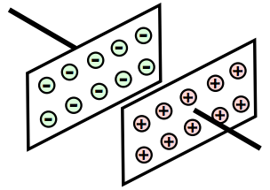
WORKING OF VARACTOR DIODE:
To know the Varactor diode working principle, we must know the function of capacitor and capacitance. Let us consider the capacitor that comprises of two plates alienated by an insulator as shown in the figure.
We know that, the capacitance of a capacitor is directly proportional to the region of the terminals, as the region of the terminals increases the capacitance of the capacitor increases. When the diode is in the reverse biased mode, where the two regions of P-type and N-type are able to conduct and thus can be treated as two terminals. The depletion area between the P-type & N-type regions can be considered as insulating dielectric. Therefore, it is similar to the capacitor shown above.

Slide 5
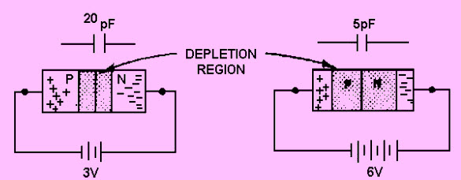
The volume of the depletion region of the diode varies with change in reverse bias. If the reverse voltage of the diode is increased, then the size of the depletion region increases. Likewise, if the reverse voltage of the Varactor diode is decreased, then the size of the depletion region decreases. Hence, by changing the reverse bias of the diode the capacitance can be changed.

Slide 6
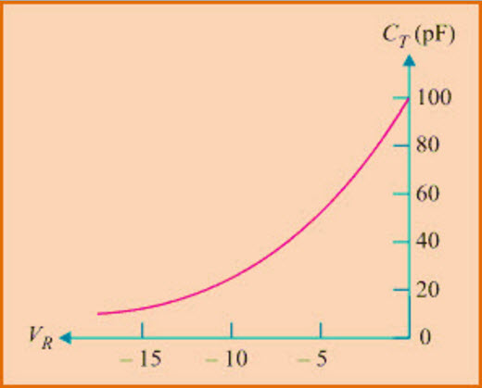
CHARACTERISTICS:
The characteristics of Varactor diode have the following:
These diodes significantly generate less noise compared to other diodes.
The cost of these diodes is available at lower and more reliable also.
These diodes are very small in size and very light weight.
There is no useful when it is operated in forward bias.
In reverse bias mode, Varactor diode enhances the capacitance as shown in the graph below.

Slide 7
ADVANTAGES AND DISADVANTAGES
a monitored voltage source to hold the value temperature sensitive Si based
dont work over 100C variable capacitors in the mechanical adjusted variety work
driven for electric control
is basically an electrically controlled variable capacitor no moving parts need

Slide 8
APPLICATIONS:
The applications of Varactor Diode mainly involve within the RF design arena However, in this article, we are discussing about the couple of applications of Varactor diodes, to illustrate how these diodes can be used in a practical. The capacitor in a practical circuit can be changed with the Varactor diode, but it is necessary to make sure the tune voltage that is, the voltage necessary to set the diode capacitance. And to ensure that this diode is not influenced by the bias voltage in the circuit. By using voltage control technique in the diode circuit, changing capacitance can be offered.

Slide 9
CONCLUSION:
Varactor diodes in reverse bias operates as variable capacitor as reverse voltage varies, where: ● Depletion region : Dielectric (Insulator) ● P - N Regions : Plates of capacitor ● Width of Depletion region : Distance of separation

Slide 10
THANK YOU

